Slide 1
Session 10
Express Framework, Building scalable web applications
Basics of Webpack & Sass and Webpack ,
JSON & AJAX,
Node.js-1and 2

Slide 2
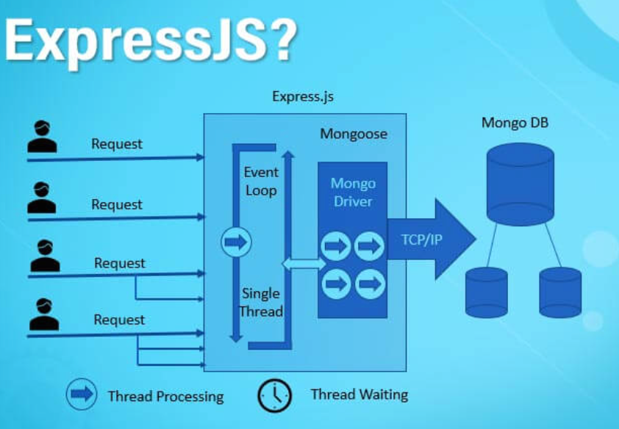
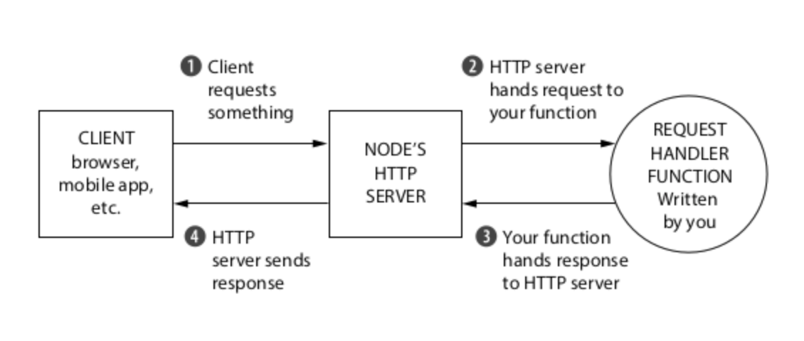
Express Framework

Slide 3
Overview:
Express is a popular web application framework for Node.js. It simplifies the process of building web applications and APIs by providing a set of robust features and middleware.
Express is known for its flexibility, simplicity, and speed.
Install node JS and NPM - install nodejs, go the homepage https://nodejs.org/en/download/ of nodejs and install the package based on your OS.
Use node -v to check version
To install express JS type : npm install express --save

Slide 4
Example:
This app starts a server and listens on port 3000 for connections. The app responds with “Hello World!” for requests to the root URL (/) or route. For every other path, it will respond with a 404 Not Found.
Save below in hello.js
const express = require('express'); const app = express(); app.get('/', (req, res) => { res.send('Hello, Express!'); }); app.listen(3000, () => { console.log('Server is running on port 3000'); });
Go to the folder where it is saved and run : node hello.js
Open from browser : http://localhost:3000/

Slide 5
Bank app using Express JS
In this example, we've created endpoints to:
Retrieve a list of all bank accounts.
Retrieve a single bank account by its ID.
Create a new bank account.
Update the balance of an existing bank account by its ID.
Delete a bank account by its ID
CRUD - CREATE , READ , UPDATE , DELETE
More examples: https://expressjs.com/en/starter/examples.html

Slide 6
Building Scalable Web Applications
Scalability is a crucial aspect of web application development. Building scalable web applications means designing your system in a way that can handle increased load and traffic without a significant drop in performance.
This often involves strategies like load balancing, database optimization, and caching.
Horizontal Scaling: Adding more server instances to distribute the load.
Vertical Scaling: Upgrading server hardware to handle more load.
Load Balancing:
Load balancers distribute incoming traffic across multiple servers to ensure optimal resource utilization and prevent overload.
eg: Using Nginx or HAProxy as a load balancer
Caching:
Caching frequently accessed data can significantly improve application performance.
eg: Implementing caching with Redis or Memcached.

Slide 7
Example:
Consider a social media platform like Twitter that needs to handle a growing number of users and tweets.
To make it scalable, you can use a distributed database, implement caching for frequently accessed data, and deploy multiple server instances behind a load balancer to distribute incoming requests.

Slide 8
Basics of Webpack & Sass
Webpack is a popular JavaScript module bundler that helps manage dependencies and optimize assets for web applications.
Sass (Syntactically Awesome Style Sheets) is a preprocessor for CSS, allowing you to write cleaner and more maintainable styles.

Slide 9
Example (Webpack):
// webpack.config.js const path = require('path'); module.exports = { entry: './src/index.js', output: { path: path.resolve(__dirname, 'dist'), filename: 'bundle.js', }, module: { rules: [ { test: /\.js$/, exclude: /node_modules/, use: 'babel-loader', }, ], }, };

Slide 10
Example (Sass):
scss // styles.scss $primary-color: #3498db; body { background-color: $primary-color; font-family: Arial, sans-serif; }

Slide 11
JSON & AJAX
JSON (JavaScript Object Notation) is a lightweight data interchange format widely used for data storage and communication.
[
{"id":1,"accountNumber":"1234567890","balance":1000},
{"id":2,"accountNumber":"9876543210","balance":500}
]
AJAX (Asynchronous JavaScript and XML) is a technique for making asynchronous requests to a server from a web page, typically using JSON for data exchange.

Slide 12
Example:
// Using AJAX to fetch JSON data const xhr = new XMLHttpRequest(); xhr.open('GET', 'https://example.com/api/data.json', true); xhr.onreadystatechange = function () { if (xhr.readyState === 4 && xhr.status === 200) { const data = JSON.parse(xhr.responseText); console.log(data); } }; xhr.send();

Slide 13
Node.js-1 and Node.js-2
Node.js is a runtime environment for executing JavaScript on the server-side.
Node.js-1 can refer to the basics of Node.js, including setting up a server and handling requests.
Node.js-2 can dive deeper into topics like event-driven programming, streams, and advanced features of Node.js.

Slide 14
Example (Node.js-1):
const http = require('http'); const server = http.createServer((req, res) => { res.writeHead(200, { 'Content-Type': 'text/plain' }); res.end('Hello, Node.js!'); }); server.listen(3000, () => { console.log('Server is running on port 3000'); });

Slide 15
Keynotes
Express Framework:
- Introduction to Express:
- Express.js is a Node.js web application framework for building web and API applications.
- Provides a robust set of features for routing, middleware, and HTTP request/response handling.
- Middleware in Express:
- Middleware functions in Express are used to perform tasks before handling requests.
- Examples include body parsing, authentication, logging, and error handling.
- Routing in Express:
- Express allows you to define routes for handling different HTTP methods and paths.
- Routes help organize your application and define how requests are processed.
- Templating Engines:
- Express can be used with templating engines like EJS and Pug to render dynamic HTML templates.
- RESTful APIs with Express:
- Express is commonly used to create RESTful APIs, allowing clients to interact with server resources through HTTP methods.
Building Scalable Web Applications:
- Scalability Concepts:
- Scalability is the ability of a system to handle increased load and traffic.
- Horizontal and vertical scaling are common strategies for handling scalability.
- Load Balancing:
- Load balancers distribute incoming traffic across multiple servers to ensure optimal resource utilization.
- Commonly used with multiple server instances or containers.

Slide 16
- Caching:
- Caching involves storing frequently accessed data in memory for faster retrieval.
- Improves application performance by reducing the load on databases and servers.
- Database Sharding:
- Sharding is a technique to distribute data across multiple databases or servers.
- Helps manage large datasets and traffic spikes.
Basics of Webpack & Sass and Webpack:
- Webpack Overview:
- Webpack is a module bundler that bundles JavaScript, CSS, and other assets.
- Helps optimize and manage project assets efficiently.
- Sass Introduction:
- Sass is a CSS preprocessor that adds features like variables, nesting, and functions to CSS.
- Simplifies CSS development and maintenance.
JSON & AJAX:
- JSON Basics:
- JSON (JavaScript Object Notation) is a lightweight data interchange format.
- Easy to read for humans and easy to parse for machines.
- AJAX (Asynchronous JavaScript and XML):
- AJAX is a technique for making asynchronous requests to the server without reloading the entire page.
- Commonly used for updating parts of a web page without a full refresh.
Node.js - Part 1 and Part 2:
- Node.js Part 1:
- Node.js is a runtime environment that allows running JavaScript on the server-side.
- Non-blocking I/O and event-driven architecture are key features.
- Example: Creating a simple HTTP server.
- Node.js Part 2:
- Node.js modules enable modular code organization.
- NPM (Node Package Manager) is used for package management.
- Example: Building a RESTful API with Express.js.

